Slide 1

AIRBNB PRICES IN EUROPEAN CITIES

Slide 2
BUSINESS QUESTION
How does the average price of Airbnb listings vary across different European cities and countries?
What main factors influence the price of Airbnb listings in European cities from the data given?

Slide 3
THE DATA
Data was sourced from Kaggle (https://www.kaggle.com/datasets/thedevastator/airbnb-prices-in-european-cities/data)
The data included 10 different European cities with prices from weekdays and weekends.
Data evaluated different attributes from room type, cleanliness rating, guest satisfaction score, number of bedrooms, and distance from the city centre.
Data was analysed using SQL and presented using PowerBI.

Slide 4
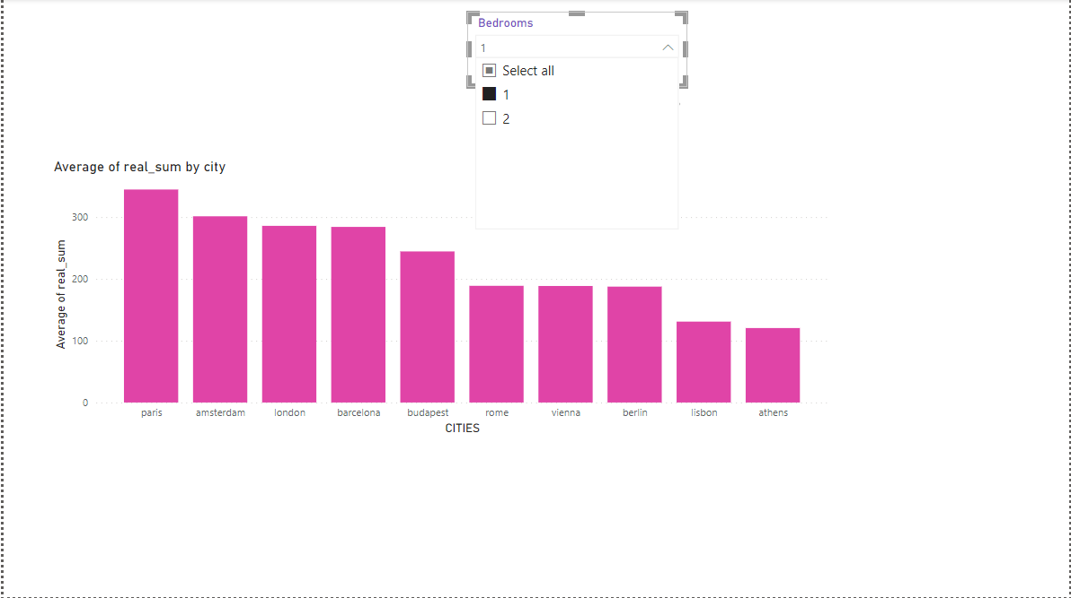
visualization by bedrooms
Comparison of the prices of one bedrooms by cities. Paris had the highest price

Slide 5
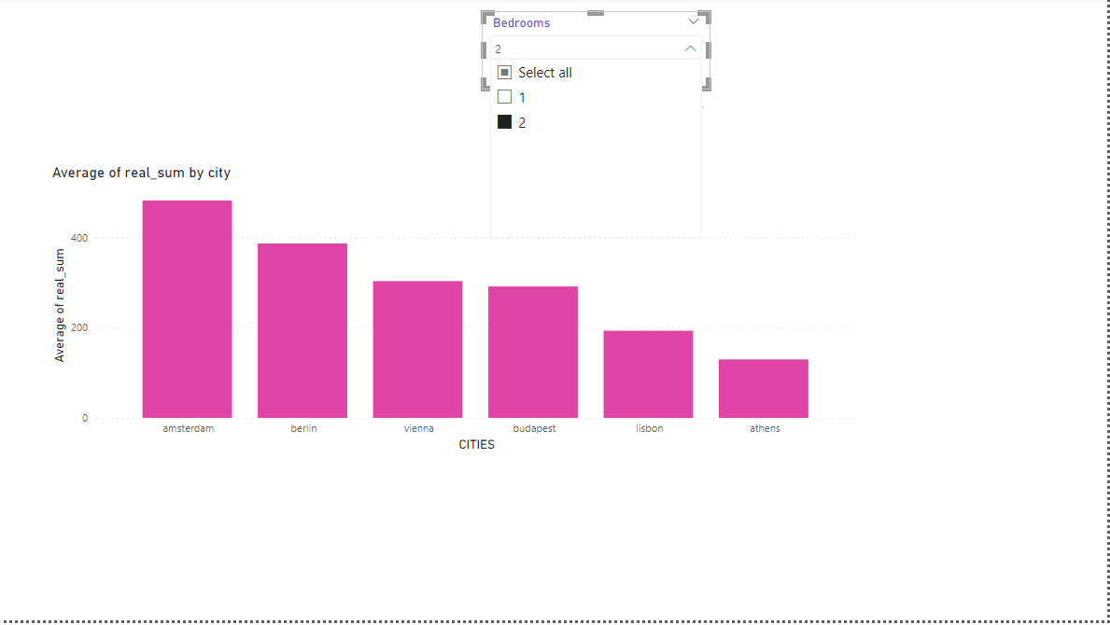
VISUALIZATION BY BEDROOMS
Comparison by 2 bedrooms by prices per city. Not all cities had 2 bedrooms. Amsterdam had the highest price.

Slide 6
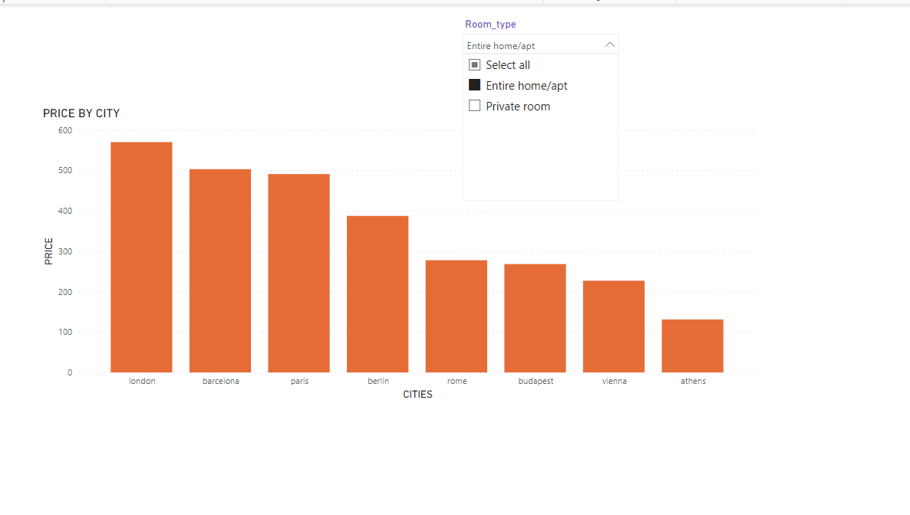
VISUALISATION BY ROOM TYPE
Where the room type is entire room/apartment. London led by the prices.

Slide 7
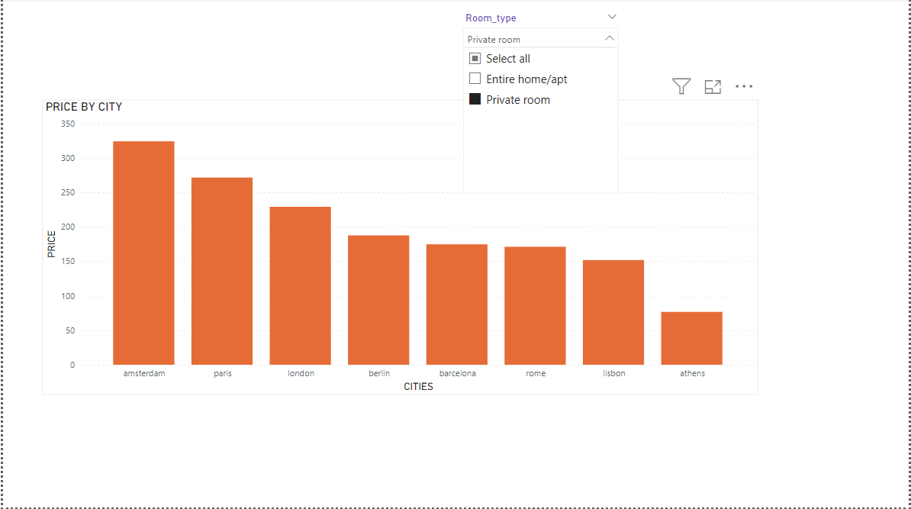
VISUALIZATION BY ROOM TYPE.
In the cities with the private rooms. Amsterdam had the highest price. Athens had the cheapest.

Slide 8
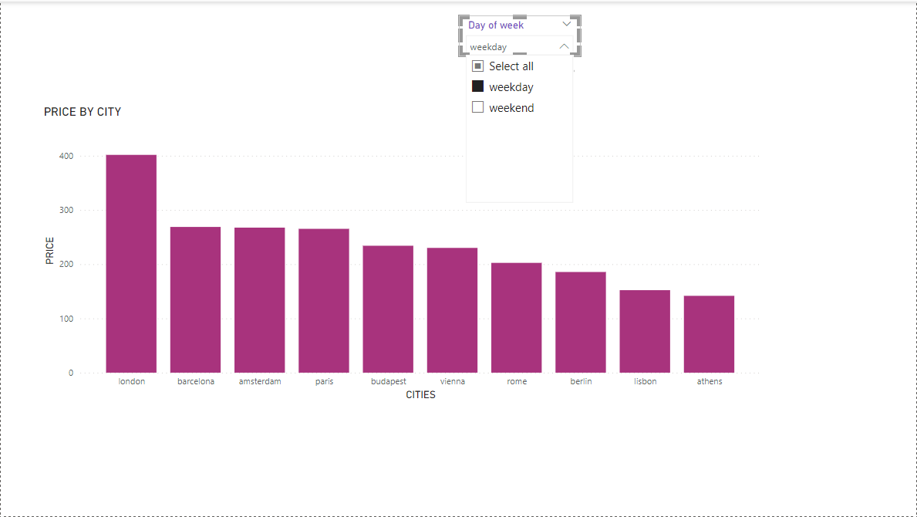
VISUALISATION BY DAY OF THE WEEK
The prices of the weekday were higher with London leading.

Slide 9
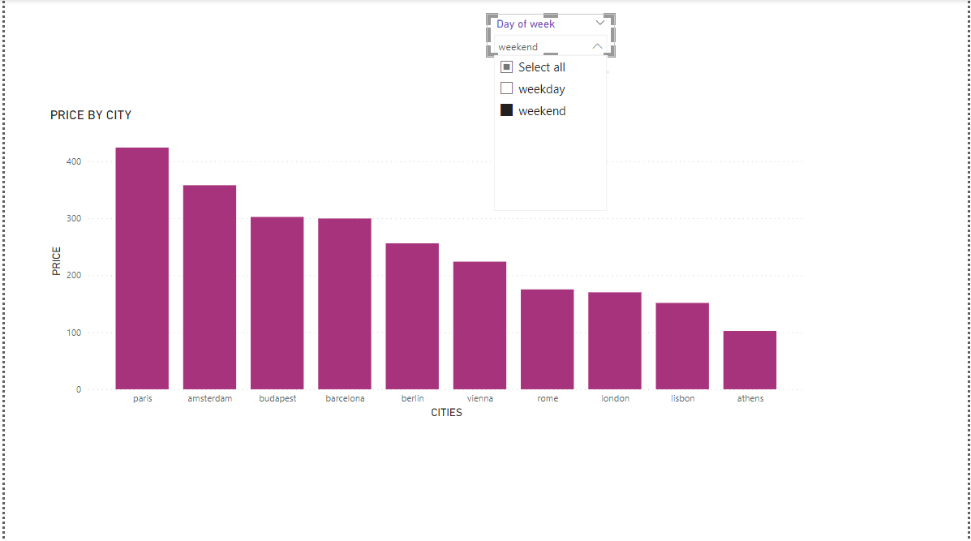
VISUALIZATION BY DAY OF WEEK.
On the weekend the prices were not high compared with the weekday.Paris had the highest price.

Slide 10
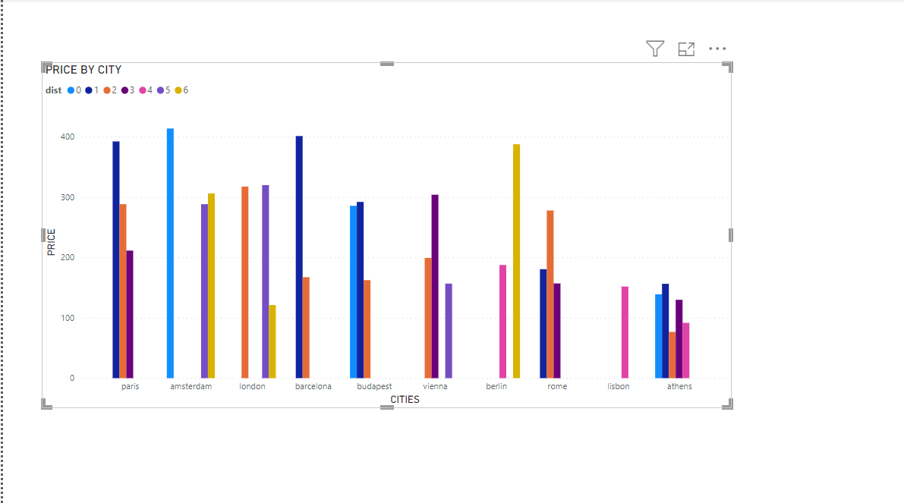
VISUALIZATION BY DISTANCE FROM CITY CENTER.
The cities that were close to the city center had the highest prices compared to cities that were far away from the city center.

Slide 11
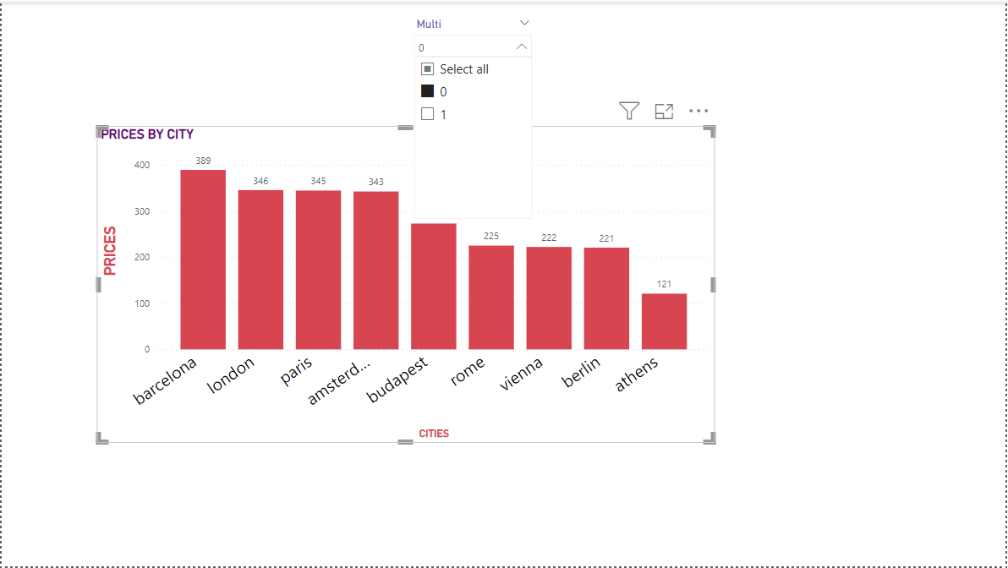
VISUALISATION BY MULTIPLE ROOMS OR NOT
The cities with had higher prices.

Slide 12
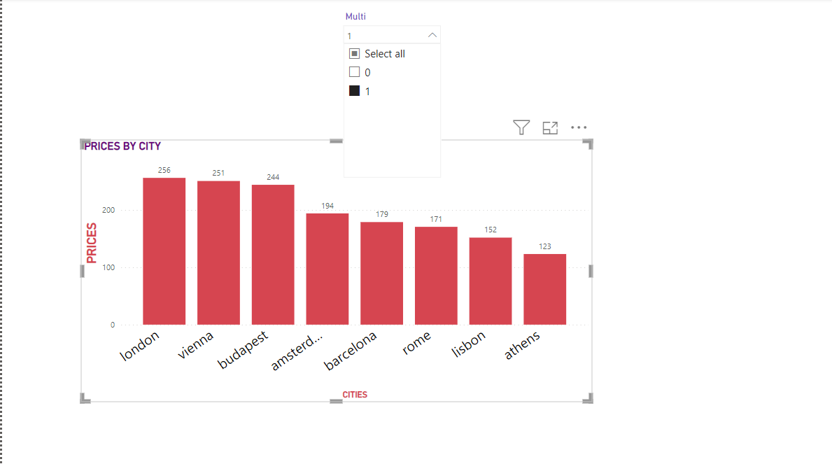
VISUALIZATION BY MULTIPLE ROOMS.
The prices in the cities were lower.

Slide 13
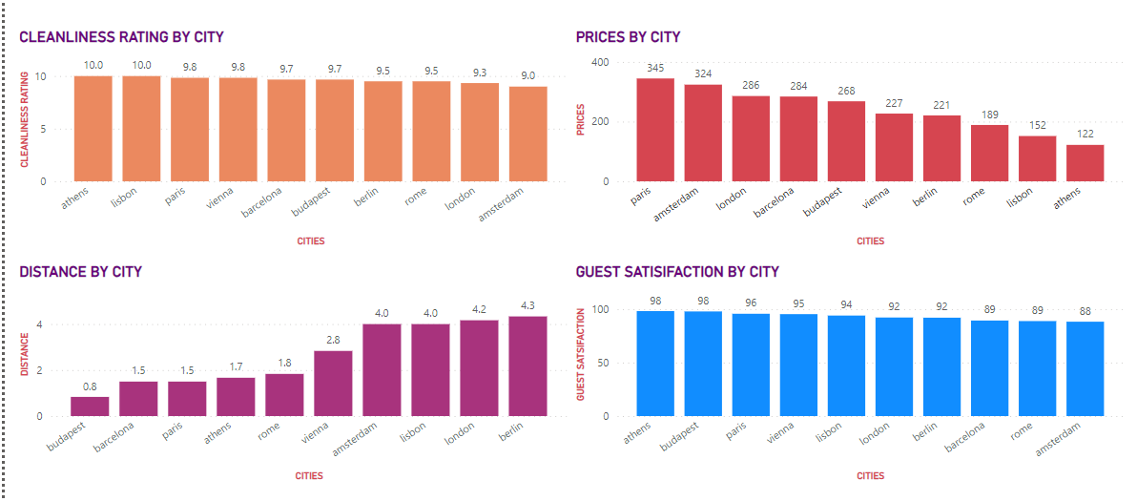
CONCLUSION OF OUR DATA.

Slide 14
CONCLUSION
Based on the analysis that we’ve conducted, it is safe to say that the number of bedrooms, room type, and day of the weeks affect the pricing of AirBnBs in different cities. On the other hand, distance from the city, cleanliness ratings and guest satisfaction don’t have an impact on pricing and therefore the pricing is independent on these factors.

Slide 15
GAPS AND OPPORTUNITIES
Datasets that contain additional information about the cities such as GDP, population, tourism, and crime can be presented. These can help the Airbnb market identify potential areas for growth.

